Slide 1
We’re on a mission to make Edinburgh a zero waste city
Coordinated by
Funded by

Slide 2
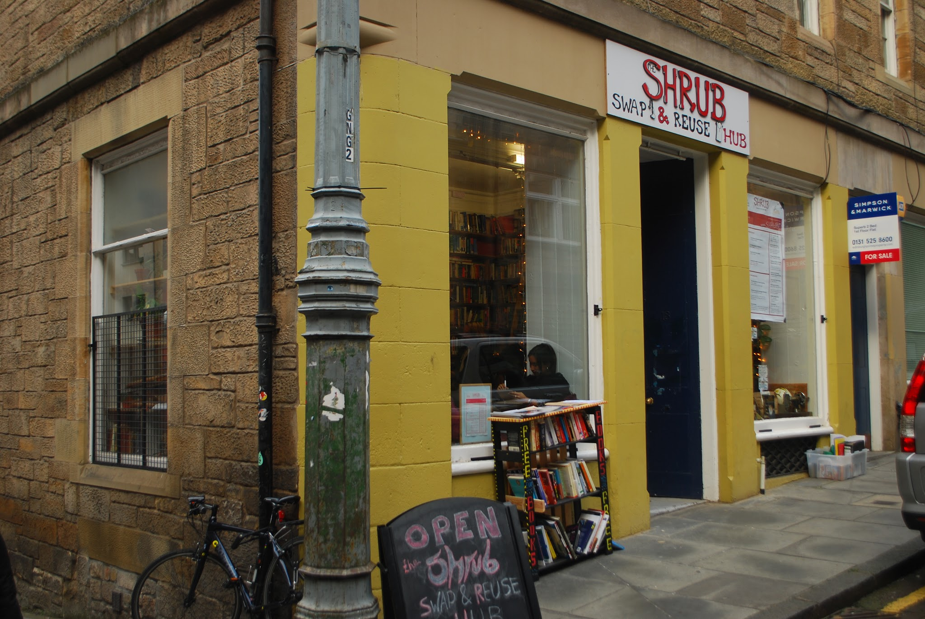
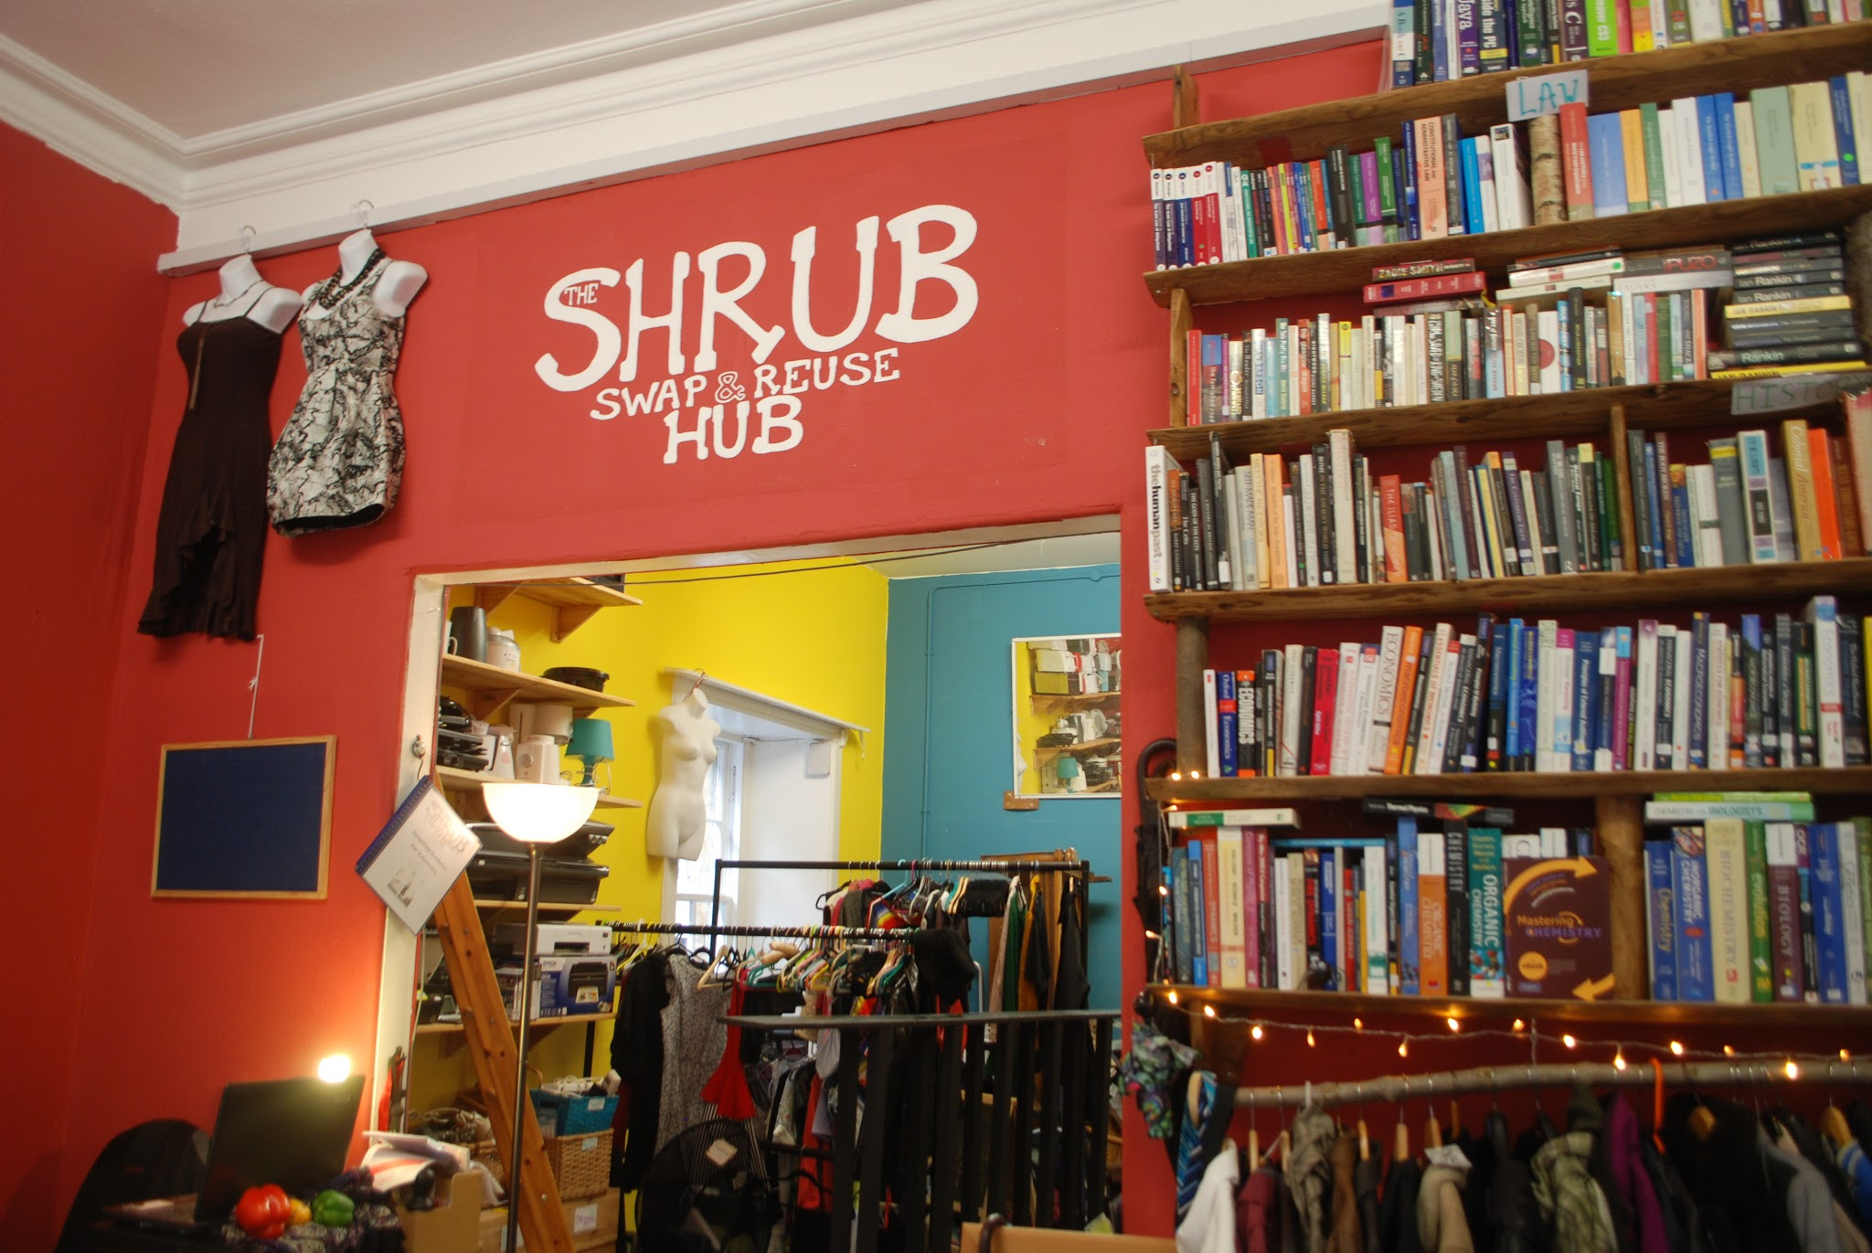
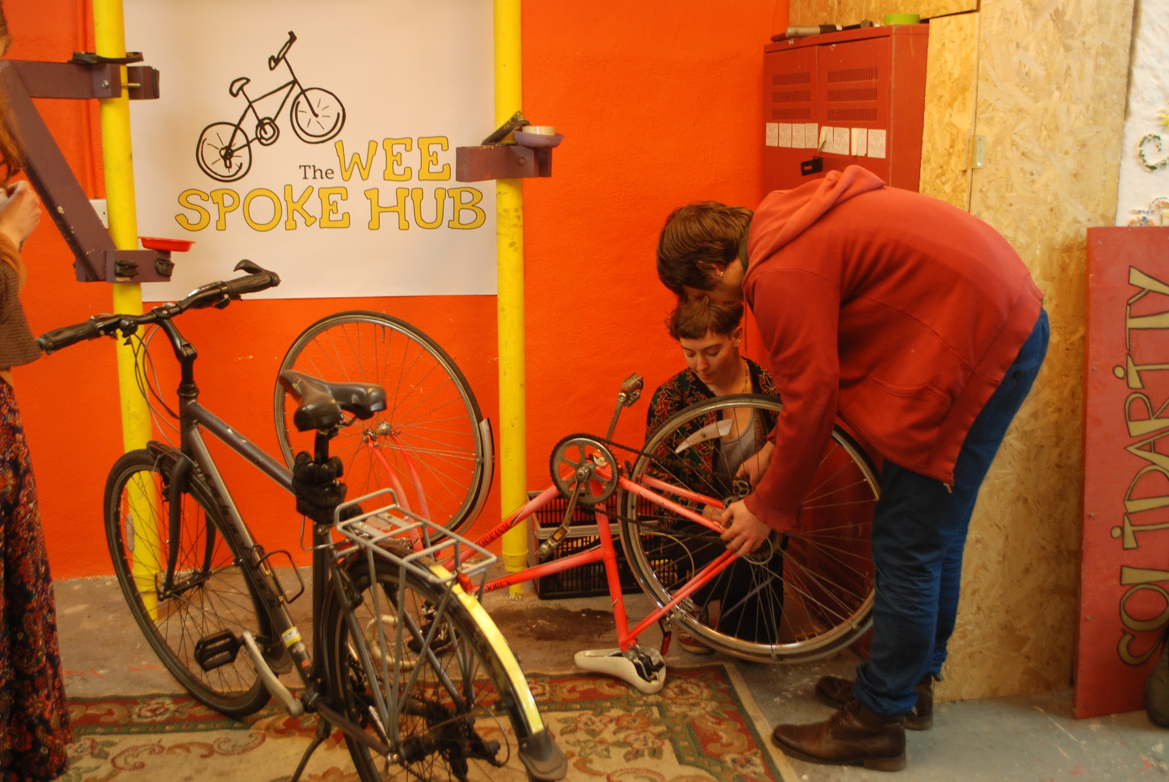
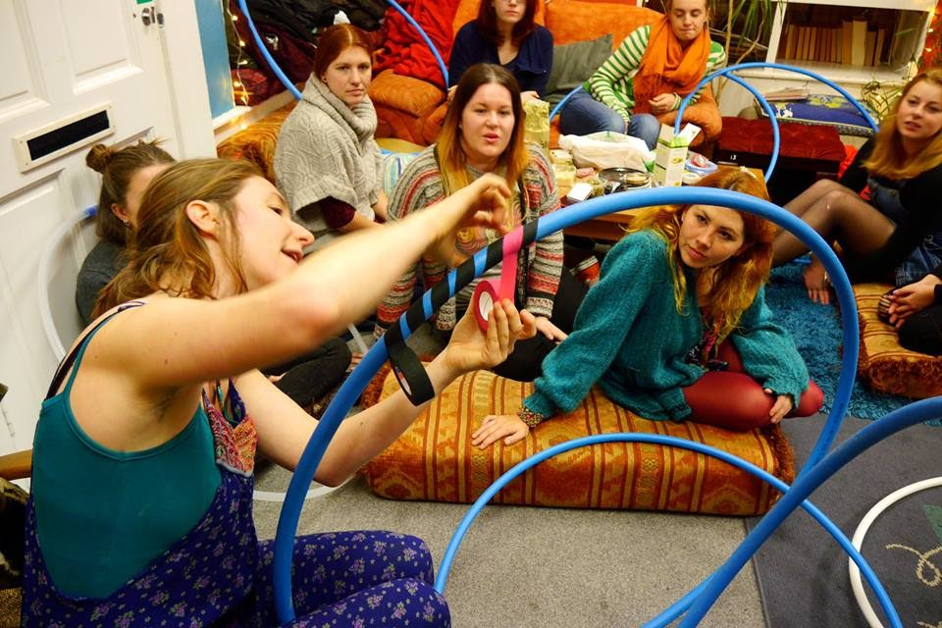
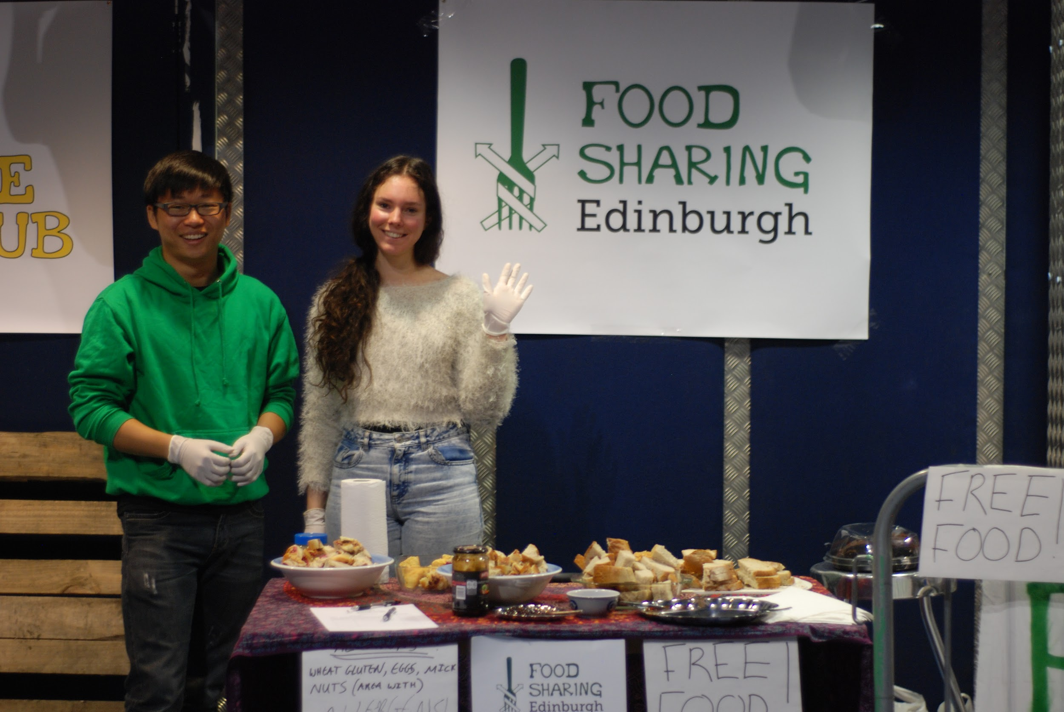
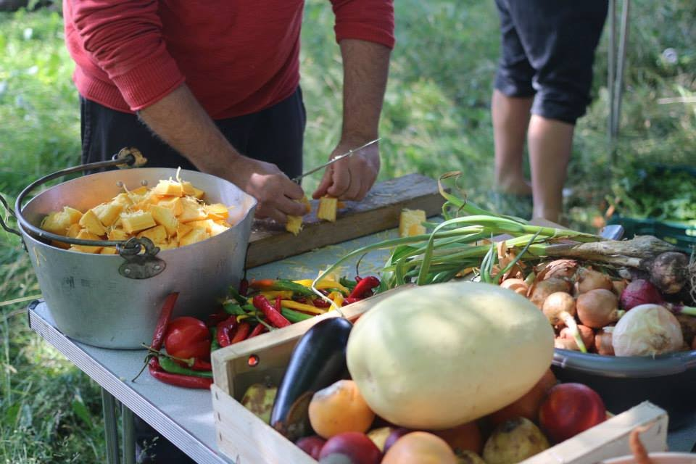
INTRODUCTION
COLLECTIONS AND FREESHOP
SWAPSHOP
Who are Shrub?
Edinburgh’s hub for creative reuse
A strong advocate, trainer, educator, and a Living Lab for the development of the circular economy in Edinburgh
A variety of projects
The UK’s first registered student-led cooperative
More than 300 members
Total carbon saved in past two years: 420.3 C02e tonnes
Over 350 volunteers in past two years
WEE SPOKE HUB
WORKSHOPS
FOOD SHARING
DISCO SOUP
Notes:
Firstly I’d like to introduce the Shrub, Edinburgh’s hub for creative reuse. The Shrub is an advocate, trainer, educator and a living lab for the development of the circular economy in Edinburgh. We run a variety of projects such as the end of year student hall collections and giving away to freeshop, we have a year round swapshop with members swapping instead of shopping, The Wee Spoke Hub shares skills for DIY bike repair, Upcyling workshops, Food Sharing activities including Disco Soup - food saved from waste plus live music.

Slide 3
for a Zero Waste Town in the centre of Edinburgh
OUR VISION
The SHRUB’s 2020 vision can be divided into four main categories:
Create a FOOD SHARING HUB .
Run a MATERIAL MATTERS Workshop Programme around upcycling
Expanding end of term COLLECTIONS for Reuse
Establishing a ZERO WASTE ADVOCATE NETWORK .
The SHRUB will operate in a ‘hub and spokes’ fashion to serve as a Living Lab for the Circular Economy
Notes:
The Shrubs vision for a zero waste town in the centre of Edinburgh would operate in a hub and spokes fashion to serve as a living lab for the circular economy. We can divide the 2020 vision into four main categories: 1. Create a Food Sharing Hub, 2. Create a dedicated repurposing and upcycling workshop programme, expand the reuse collections and build a zero waste advocate network.

Slide 4
SUB-PROJECTS
FOOD SHARING HUB .
MATERIAL MATTERS Workshop Programme
COLLECTIONS .
ZERO WASTE ADVOCATE NETWORK .
Notes:
The four main sub-project proposed in the shrub ZWT include - A Food Sharing Hub, Workshops, Collections and a Zero Waste Advocate Network

Slide 5
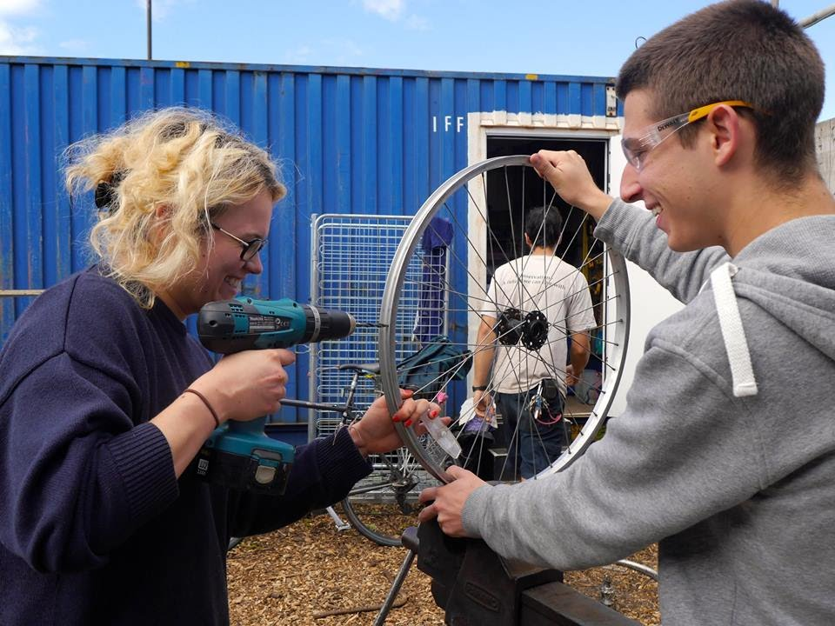
MATERIAL MATTERS Workshop Programme
What? Targeted programmes around 4 specific resources for 6 month periods (textiles, metals, furniture and electronics)
For who? To people living, working and studying within the target area
Why? To teach people how to repurpose unwanted resources
How?
6 months of intensive study, awareness raising, knowledge and skills related to the issues with one material seen as ‘waste’.
5 Phases: Research phase, Inform and educate phase, Skill and train phase, Development and enterprise phase, Legacy phase
A Circular Economy Coordinator and Working Group Volunteers
Traineeships and social enterprises created
Quantitative Outcomes
Total number of Volunteer hours: 1194
In-kind contribution living wage costs £9850.50
Total number of people engaged: 6558
8.9 tonnes of textiles, metal, electronics, furniture and plastics waste
Notes:
The Workshop sub-project will target 5 specific resources (textiles, metal, furniture, electronics and plastic). The aim of the programme is to teach people how to repurpose unwanted resources and a 6 months intensive study, awareness raising, knowledge and skills will be carried out for each of the 5 materials. The workshops programme will be coordinated by the Circular Economy Coordinator and their working group of volunteers. We estimate 1194 volunteer hours worth almost 10,000 pounds with over 6500 people engaged and 8.9tonnes repurposed over the 3 year period.

Slide 6
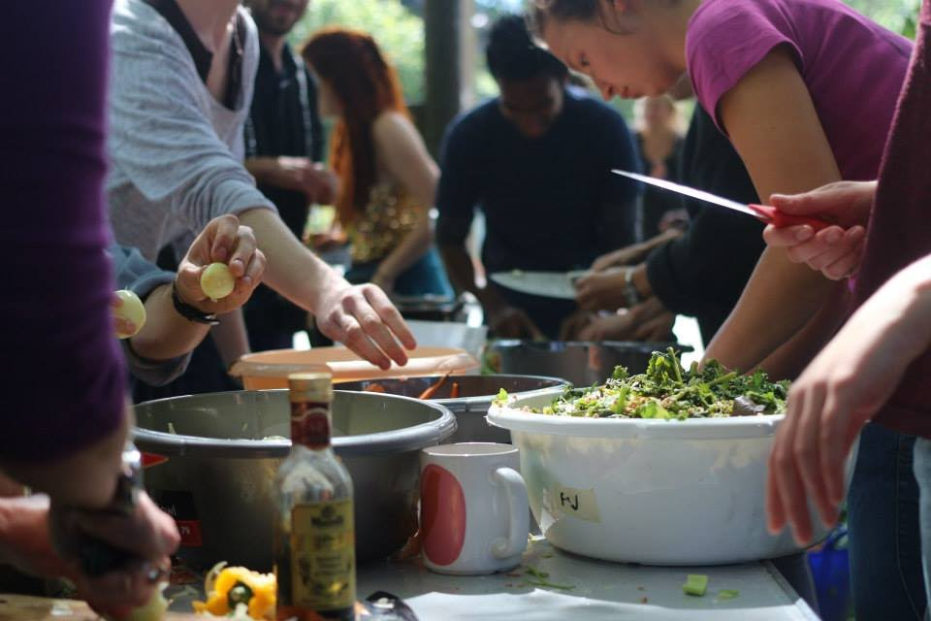
FOOD SHARING HUB .
A space to ...
Distribute surplus food
Facilitate social cohesion
Educate
Create strategies for waste reduction
Redistribute surplus food for pupils and provide an educational programme
Quantitative Outcomes
Total number of volunteer hours throughout project: 83256
In-kind contribution living wage costs £686,862
Total number of businesses engaged: 29
Total number of people engaged: 25918
Total food waste reduction over 3 year project: 273.1 tonnes
Notes:
The food sharing sub-project will be a space to distrubute surplus food - educate and create strategies for waste reduction and it will redistribute surplus food for pupils and provide an educational programme. The quanitative outcomes will include over 83,000 volunteer hours worth in-kind in octs of wages almost 700,000 pounds. The total no. of businesses engaged will be 29 with nearly 26000 people engaged and the food waste reduced will be 273 tonnes in the first 3 years

Slide 7
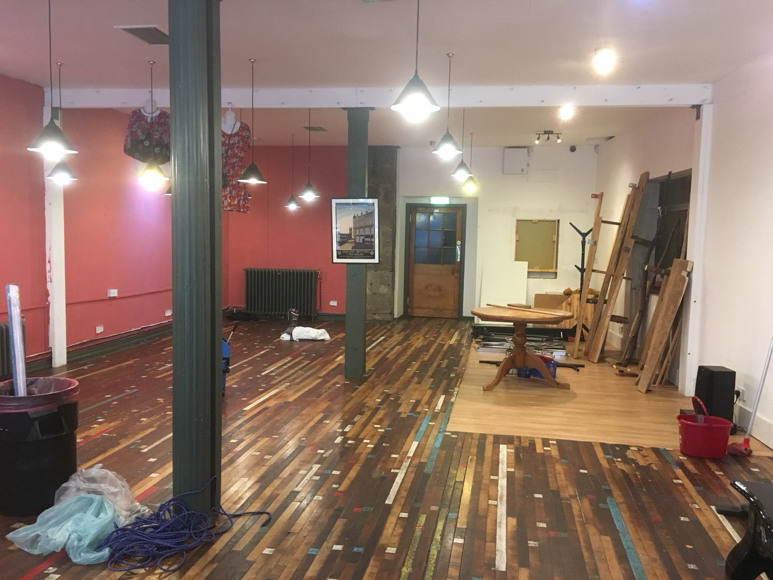
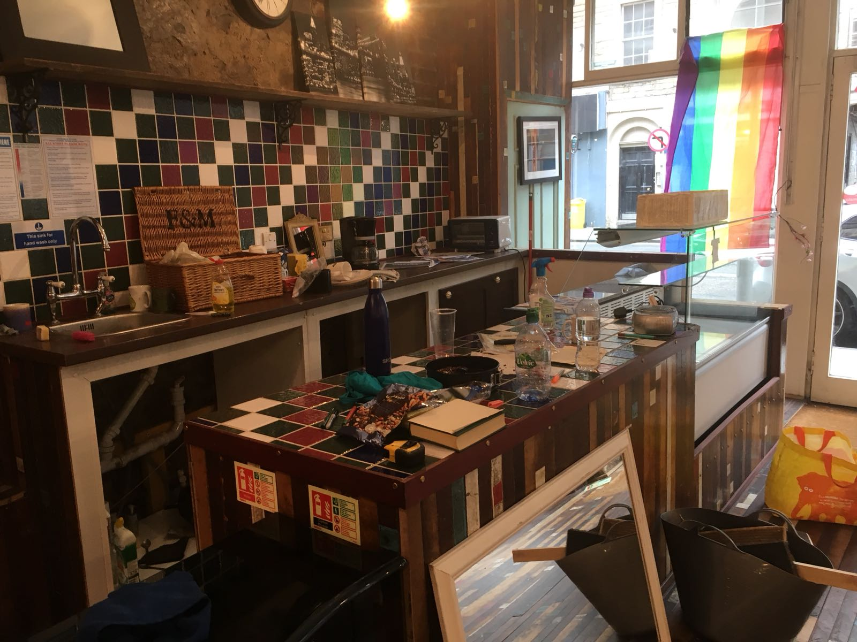
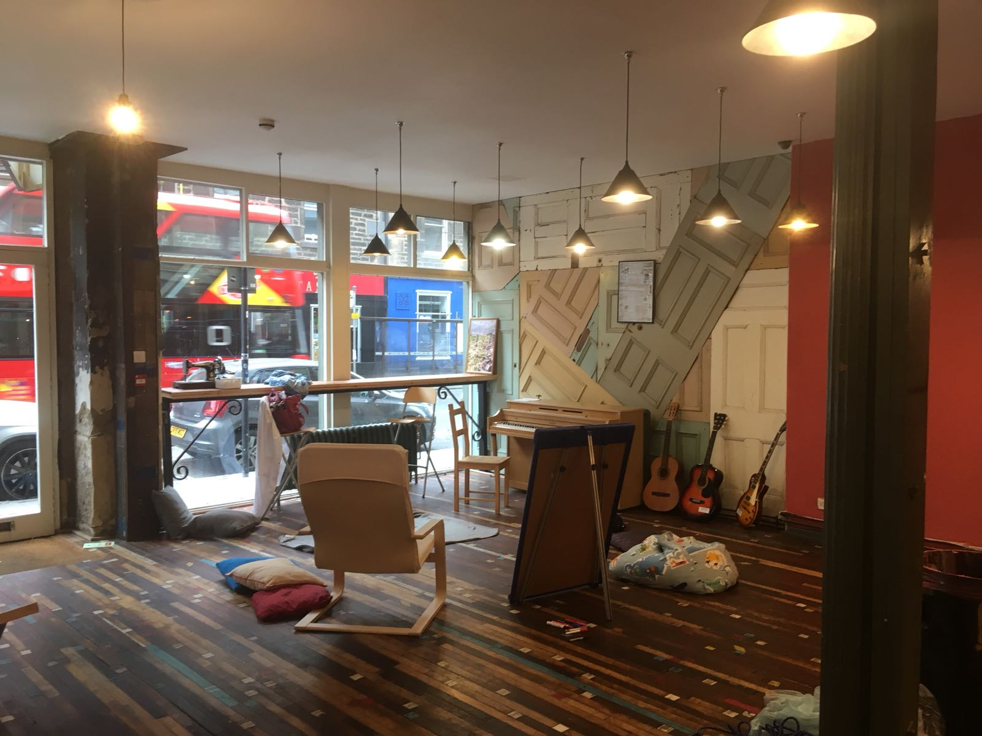
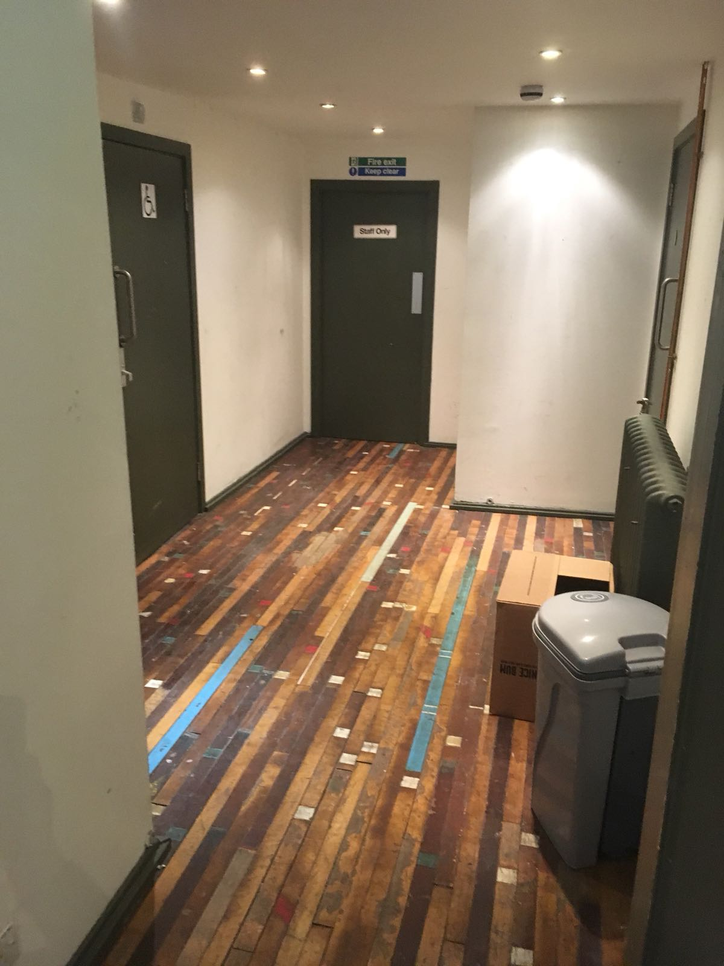
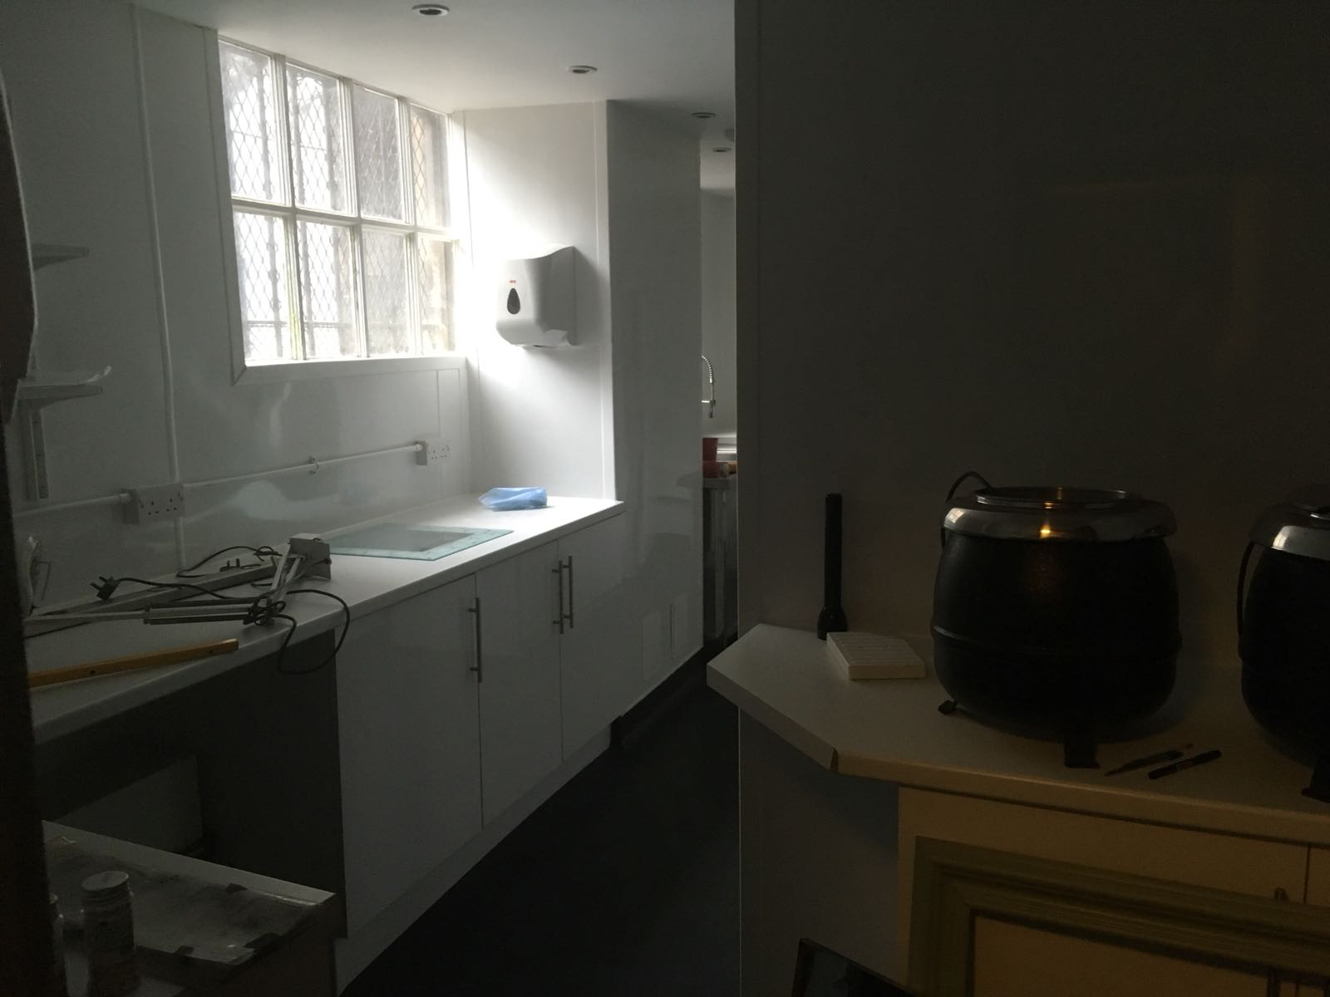
BREAD STREET
https://www.youtube.com/watch?v=cbKHuCeS3E8
Notes:
The four main sub-project proposed in the shrub ZWT include - A Food Sharing Hub, Workshops, Collections and a Zero Waste Advocate Network

Slide 8
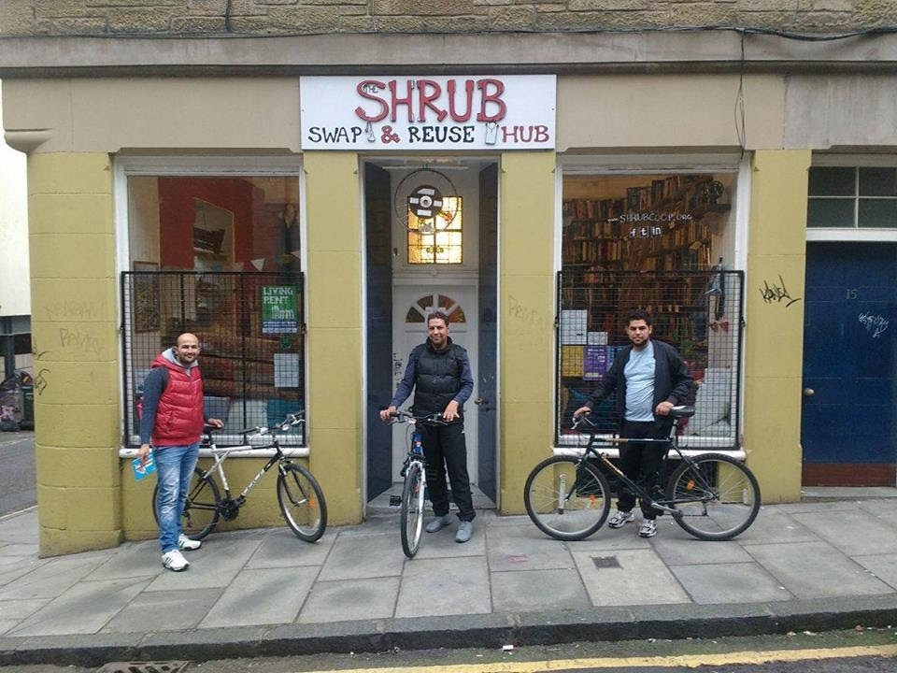
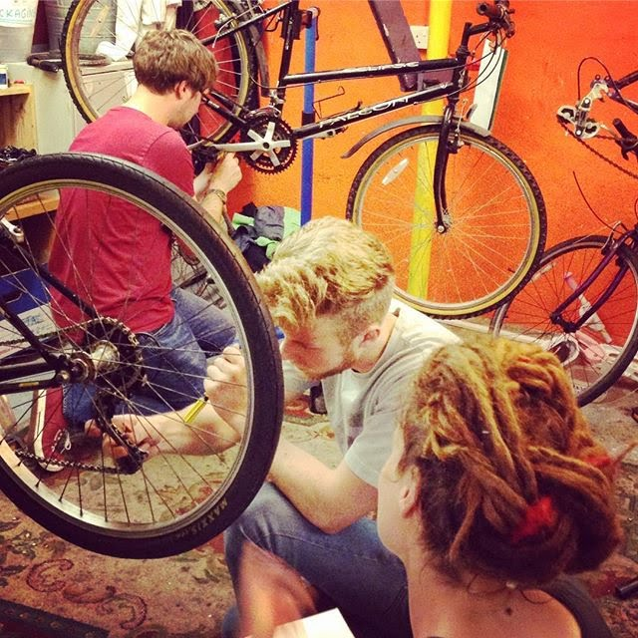
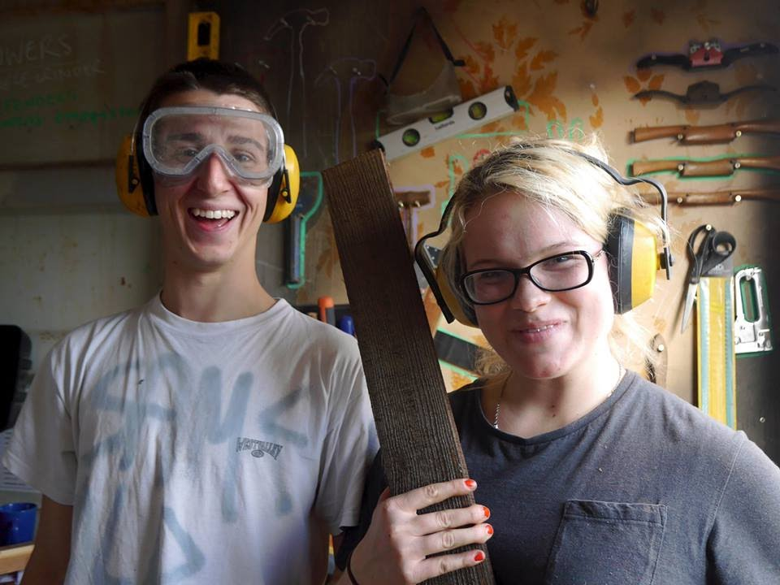
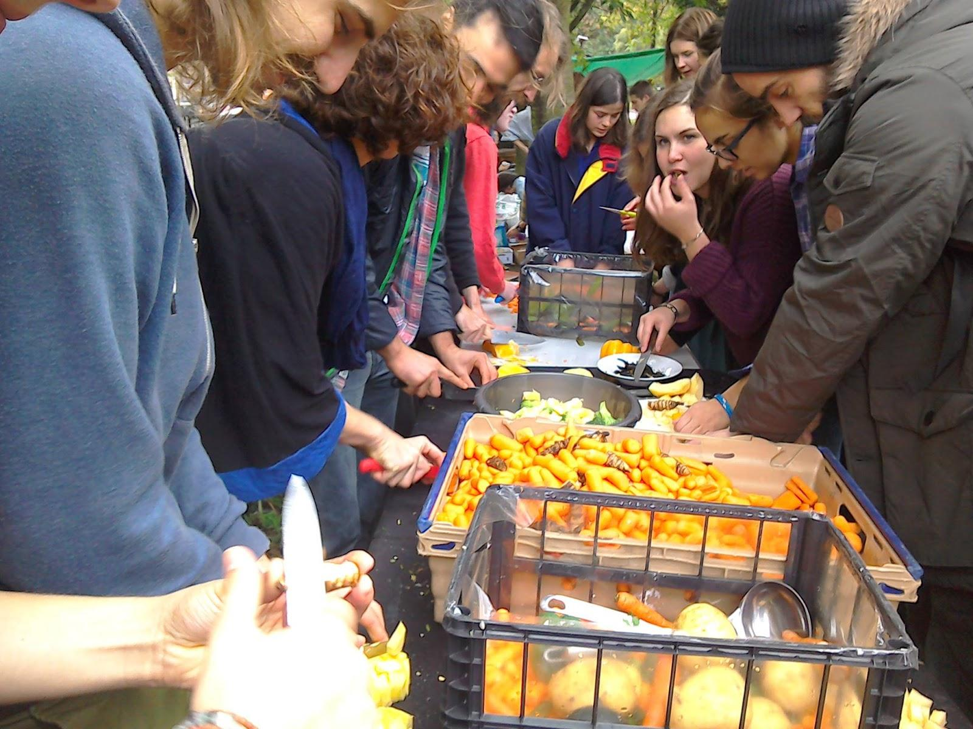
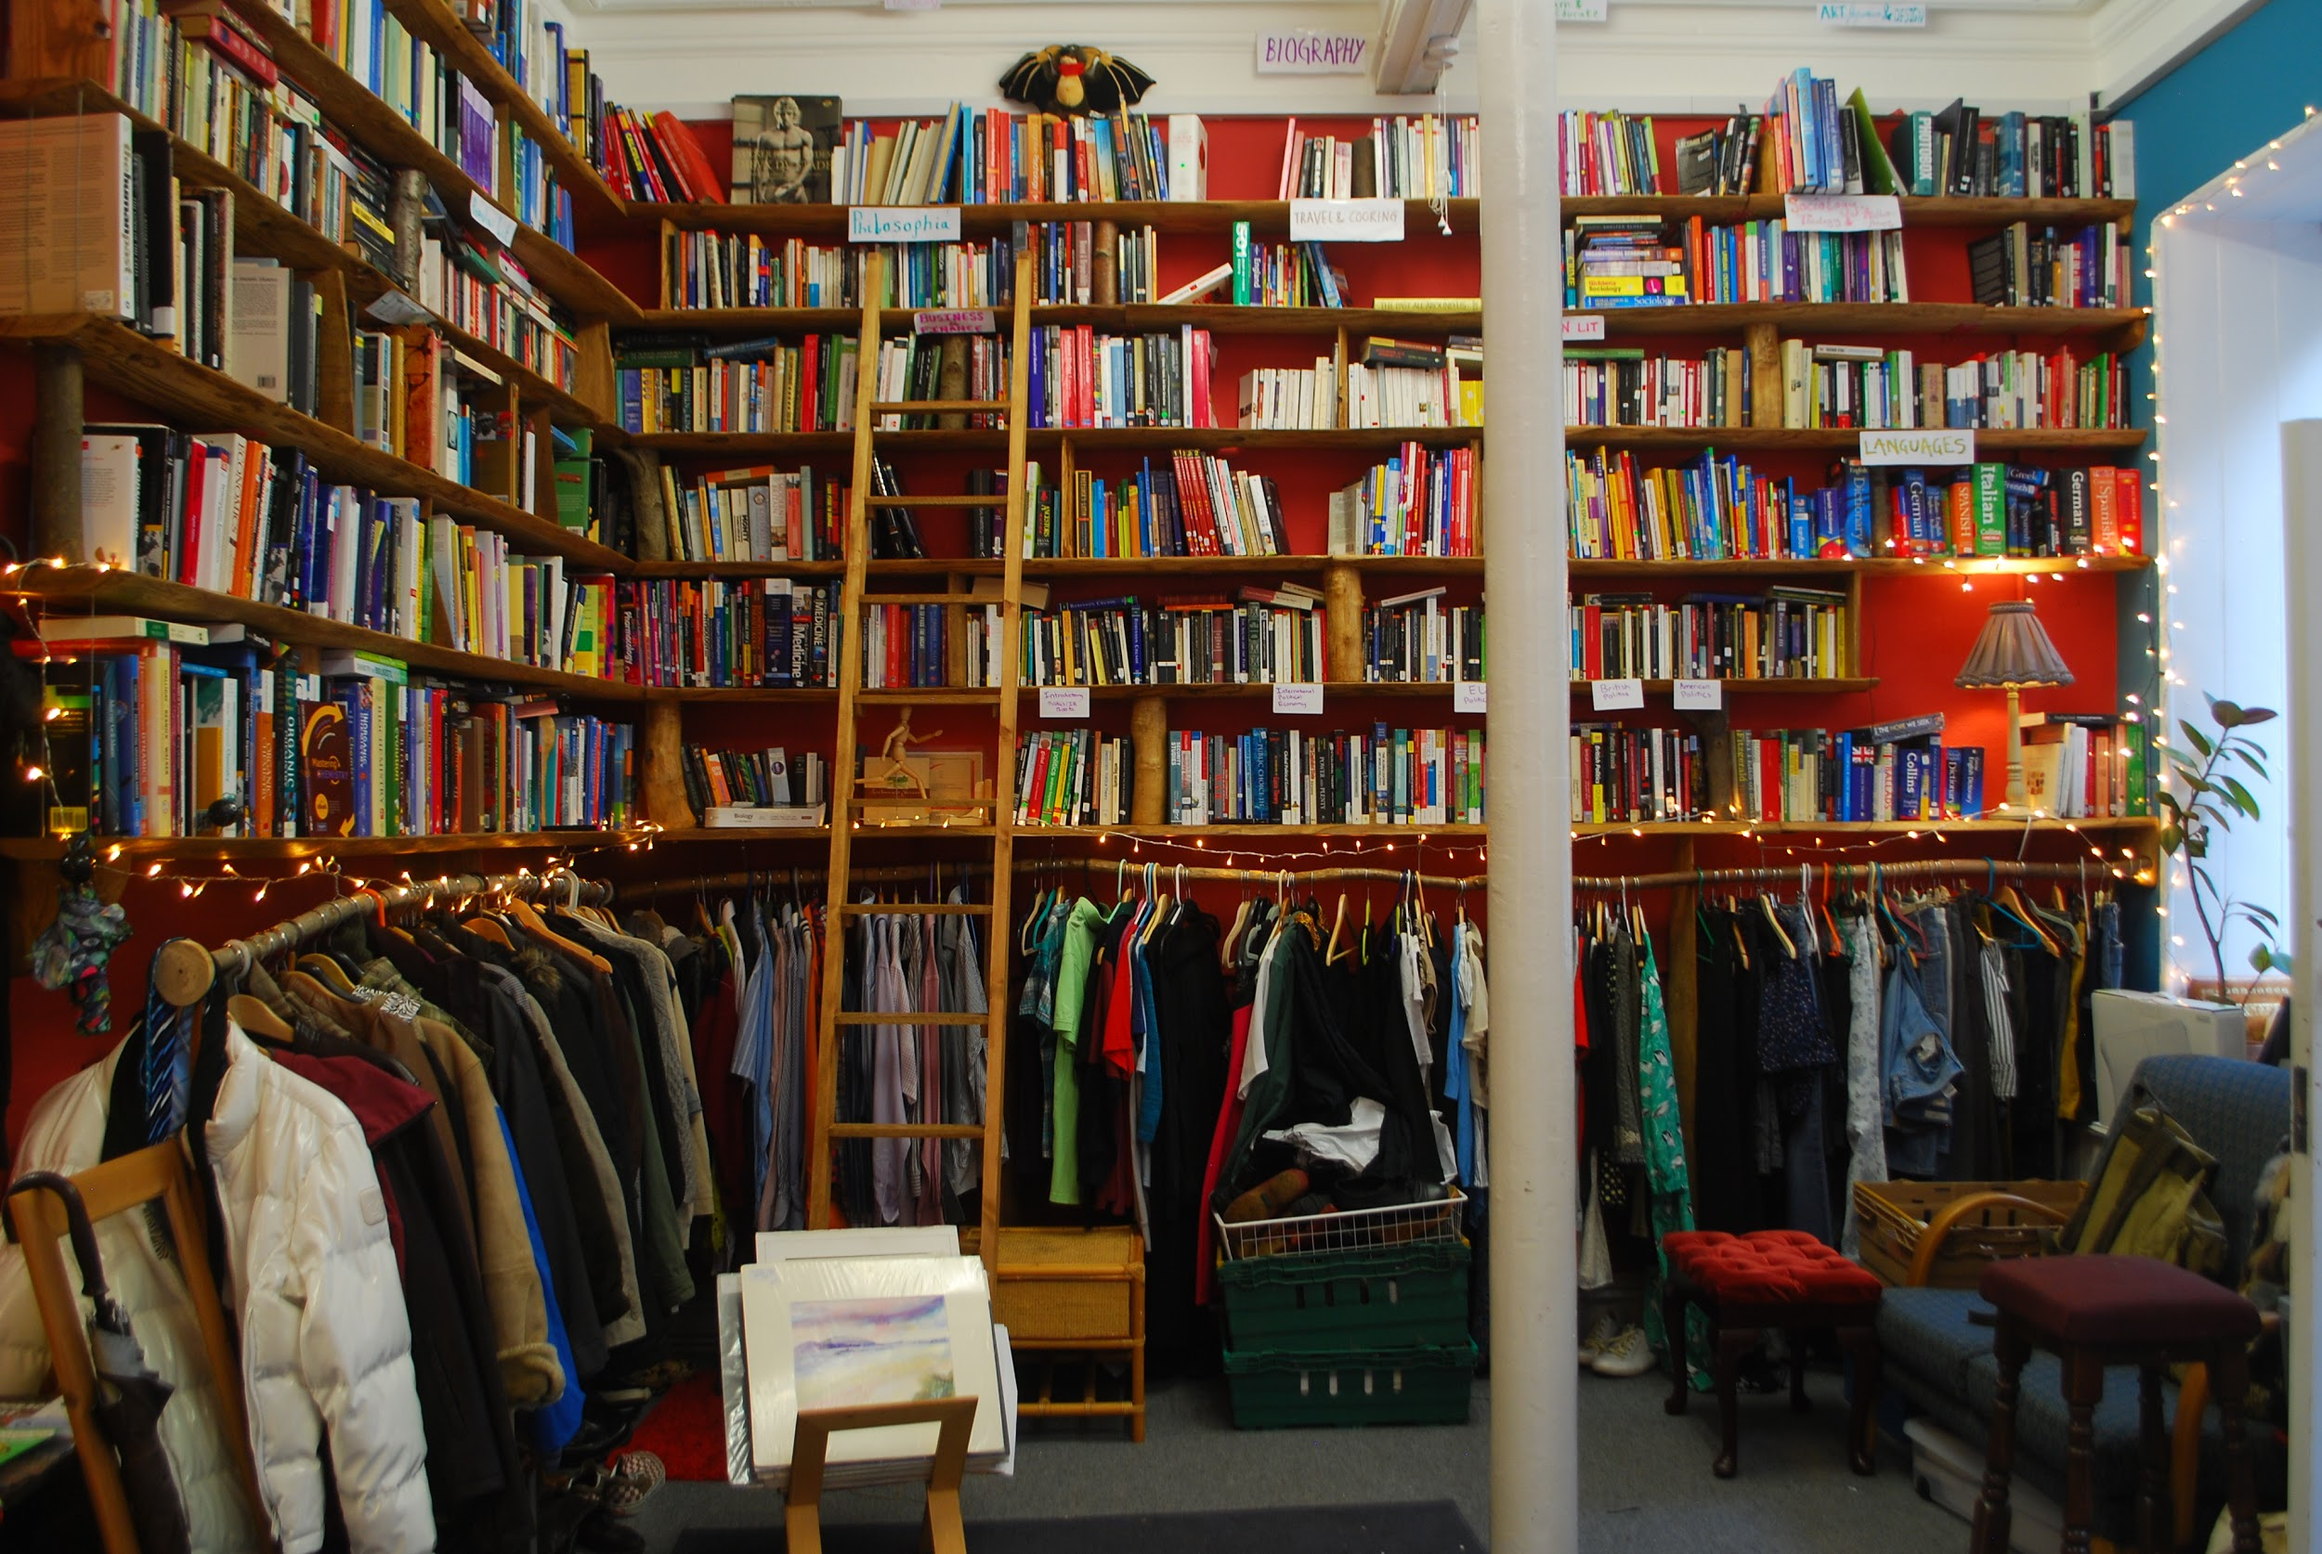
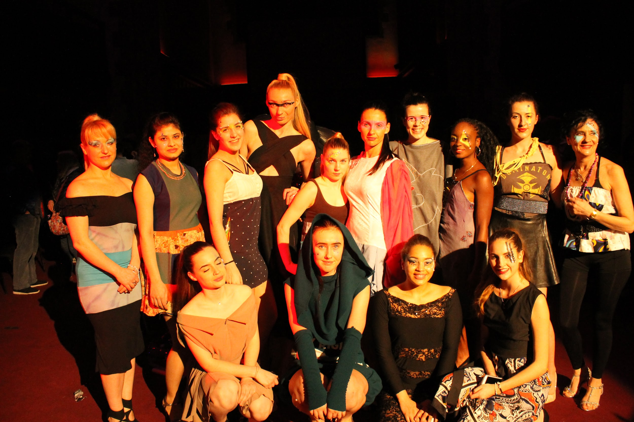
THANKS!
Notes:
Update: 5 part-time staff hired for ZWT. Other SHRUB activities & staff (7 part-time) funded until March 2018, with continuation funding bid for from CCF for 2-year extension. Summary of CCF application (2018-2020) to follow shortly.
Joe Thompson, Project Co-ordinator

