Slide 1
Resource Efficiency Workshop
Alan Peddie, Department for Social Responsibility and Sustainability
Notes:
Thank you everyone for coming along today my name is Alan Peddie and I work at the SRS Department and this is the 4th annual meet up.
Originally we ran this workshop for just the Waste Coordinators but this is the second meet up we have extended it to, not just Warp it members, but anyone who is interested.

Slide 2
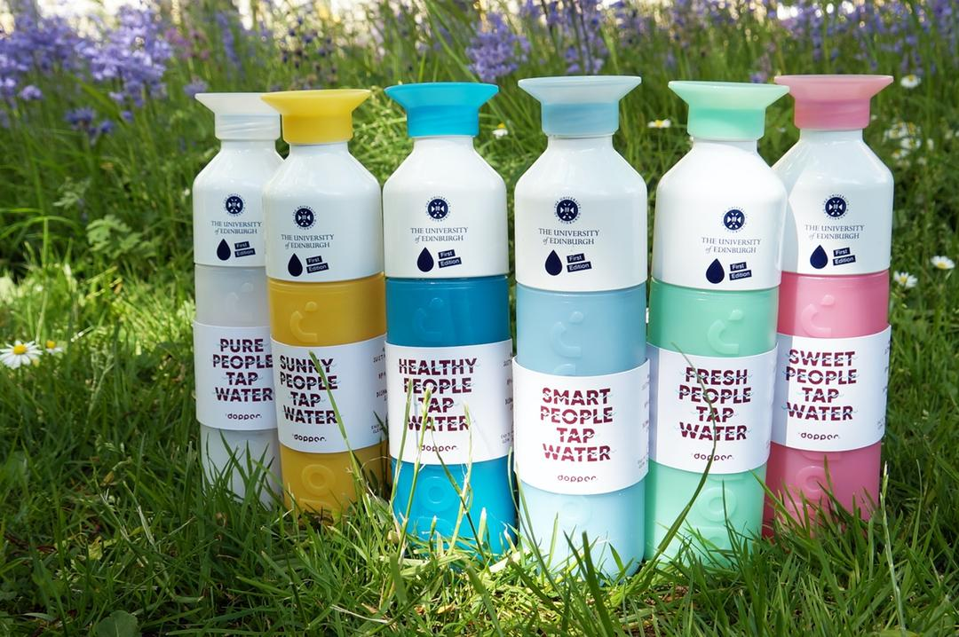
Agenda
SRS Update
Waste
Water and Coffee Cups
Zero Waste Towns
Food Sharing
Remade in Edinburgh
Coffee, muffins and prizes!
Notes:
So we have a pretty packed schedule.
I will give you an update on the Waste and Warp it networks as well as a few other bits and bobs
Kate Fitzpatrick will be giving us an update on all things Waste
Joe from SRS will giving an update on Water and Coffee Cups
We have 3 external presenters with the Zero Waste Towns project and Food Sharing both out of the SHRUB organization
Finally Remade in Edinburgh are here to talk about the work they do

Slide 3
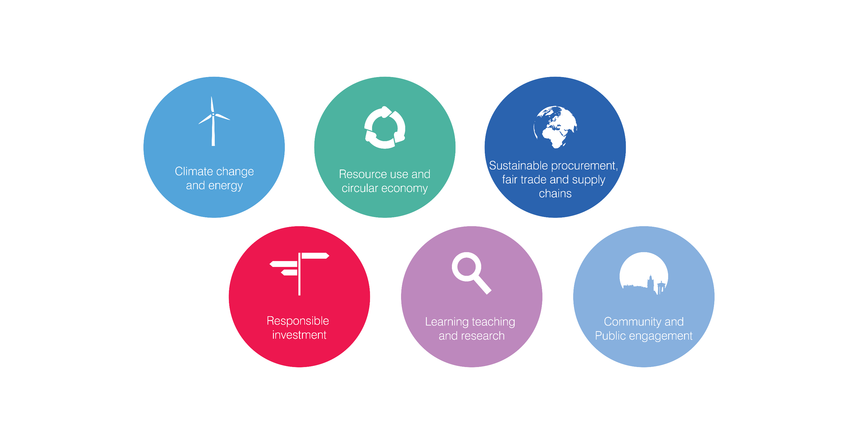
What SRS does and priorities
Providing high quality advice, support and action on social responsibility and sustainability
Notes:
So my name is Alan Peddie and I work at the Department for Social Responsibility and Sustainability.
We are a department that provide advice and support in that area
We break it down in various different categories, one of which is resource use and circular economy.
We work closely with the Waste Team on a few different projects, two of which are the use of Warp it, our resource distribution website and the Waste and Recycling Coordinator network, of which some of you belong.

Slide 4
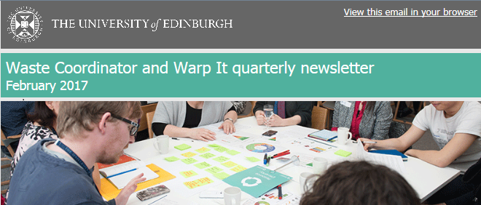
What is a Waste Coordinator?
Contact for best practice
Tailored
Newsletter
Training
Events
Case studies
Notes:
So what is a waste coordinator? “…central to the implementation of waste and recycling practices.”
Essentially they are a network people who are central to the implementation of waste and recycling practices.
They are usually a person responsible for getting the word out in their area about best practice in the area of waste.
Occasionally also training opportunities arise. The way we try to help coordinators do this is through a soft touch approach where we offer best practice and news through a quarterly newsletter
e and we try and pass out that information too.
We also are always on the hunt for people doing great things in their area and it is great that both the IAD and Roslin.

Slide 5
Last 12 months, Coordinators
Growth in network from 59, 104 to 169 in two years!
IAD and Roslin case studies online
More emails
Notes:
We did have a cull so we did get rid of dead emails from our list (people who have left the University for instance) but we have still seen growth which is really encouraging.
We are in the process of updating our website so will soon have a consolidated space for case studies like the great paper reduction and plastic bottle reduction projects ran by the IAD and Roslin.
We have been emailed a lot more by you guys about specific requests to your area which is encouraging also.

Slide 6
Survey results
32 of you responded
Useful rating 3.5/5
Impactful 3.3/5
Comments
Next steps
Notes:
It’s only as good as it’s users
Print off comments and highlight some of the key ones

Slide 7
Last 12 months, Warp it
Users 900
Active users 196
Total savings of £470k
Yearly savings are up!
More diverse items
Notes:
Again we did an email cull
So we have had over 1,000 people sign up to Warp it but actually there at the last count 214 people have logged on in the last 3 months (active users)
Last year this figure was 212, so we are pretty much rolling with a core group of 200 people around the University logging in every 3 months
Total savings are approaching £500k
The best indicator of growth is our yearly savings which is over £180k, mostly due to our IT reuse and some extra lab items used
We have seen a more diverse range of equipment like cameras, bike trailer, marquee, amplifier, Digi lock, lab equipment

Slide 8
Warp it feedback
Feedback pop up
92 respondents = 9/10
“It's a light in the darkness fighting decadence, consumerism and waste.”
“There isn’t anything on the site I want!”

Slide 9
Electronic Reuse
400 to 750!
3,000 recycled a year roughly
Award winning project
Notes:
Warp it has continued to grow at a steady rate and demand is absolutely beginning to outstrip supply where most items now are claimed very quickly
The most desirable of these items has been the growth of the PC reuse project where we are getting more and more on the site every month
IS are in the process of taking on our PC reuse intern, Bradley, who is here today. The hope is that reuse will be done on an even bigger scale than is being done presently.
Also you bunch of cheeky so and so’s we all now know that you love getting two monitors and they are by far the items that are claimed the quickest,
Did you know that over 800 monitors have been reused on Warp it since we bought the portal 3 years ago

Slide 10
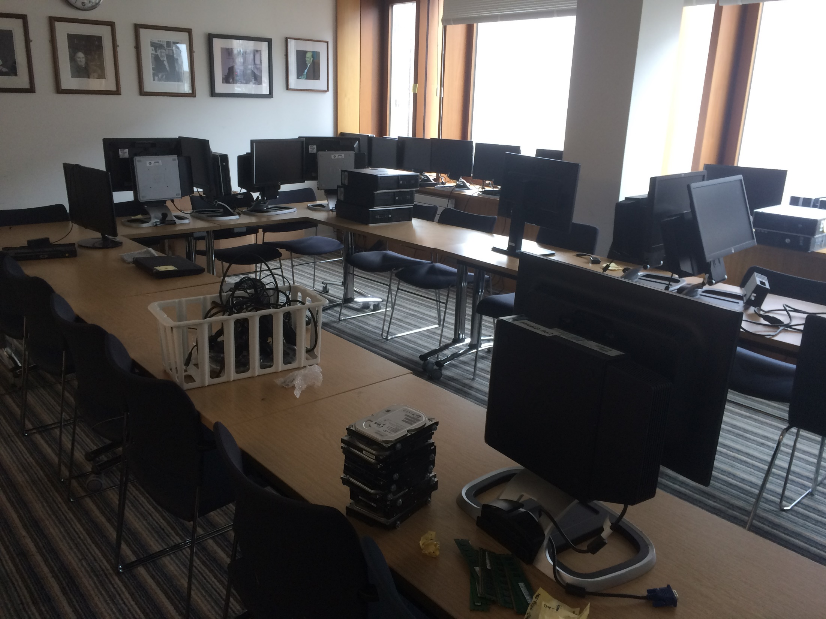
Next 12 months
Lab progress
Furniture possibilities
More external links
Future scanning
IT Reuse
Updated website
Notes:
On top of what we did this year we hope to either expand or improve these areas

Slide 11

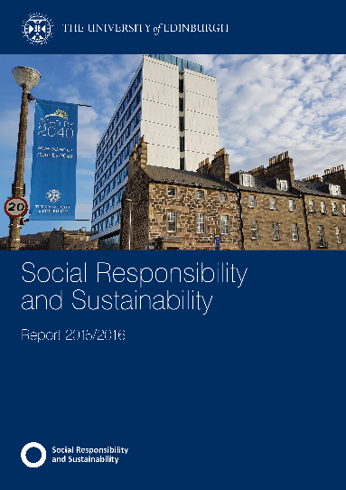

Questions?
Alan.Peddie@ed.ac.uk
www.ed.ac.uk/sustainability
Notes:
We do some time to feedback and you can catch me on the break but if there are any burning questions, feel free to ask

Slide 12
Break out session
Slido.com (code 9032)
2 flipcharts
Post it note feedback
Raffle

