Slide 1
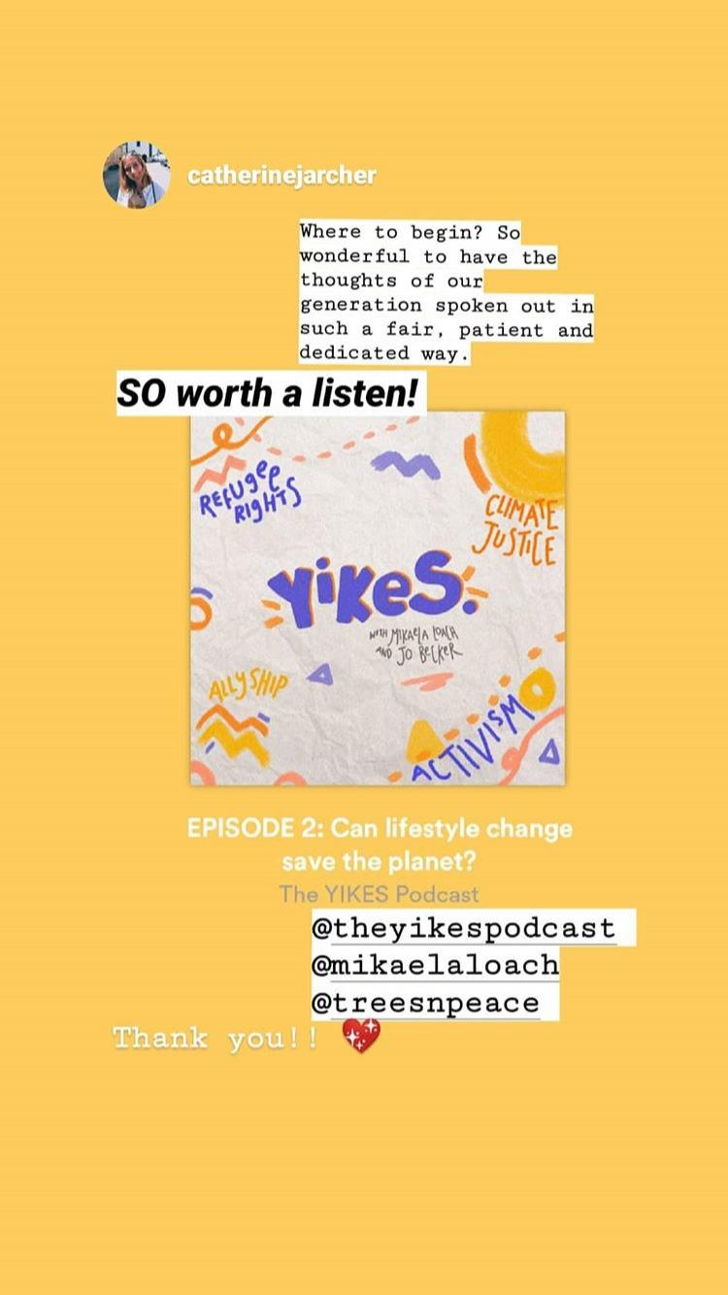
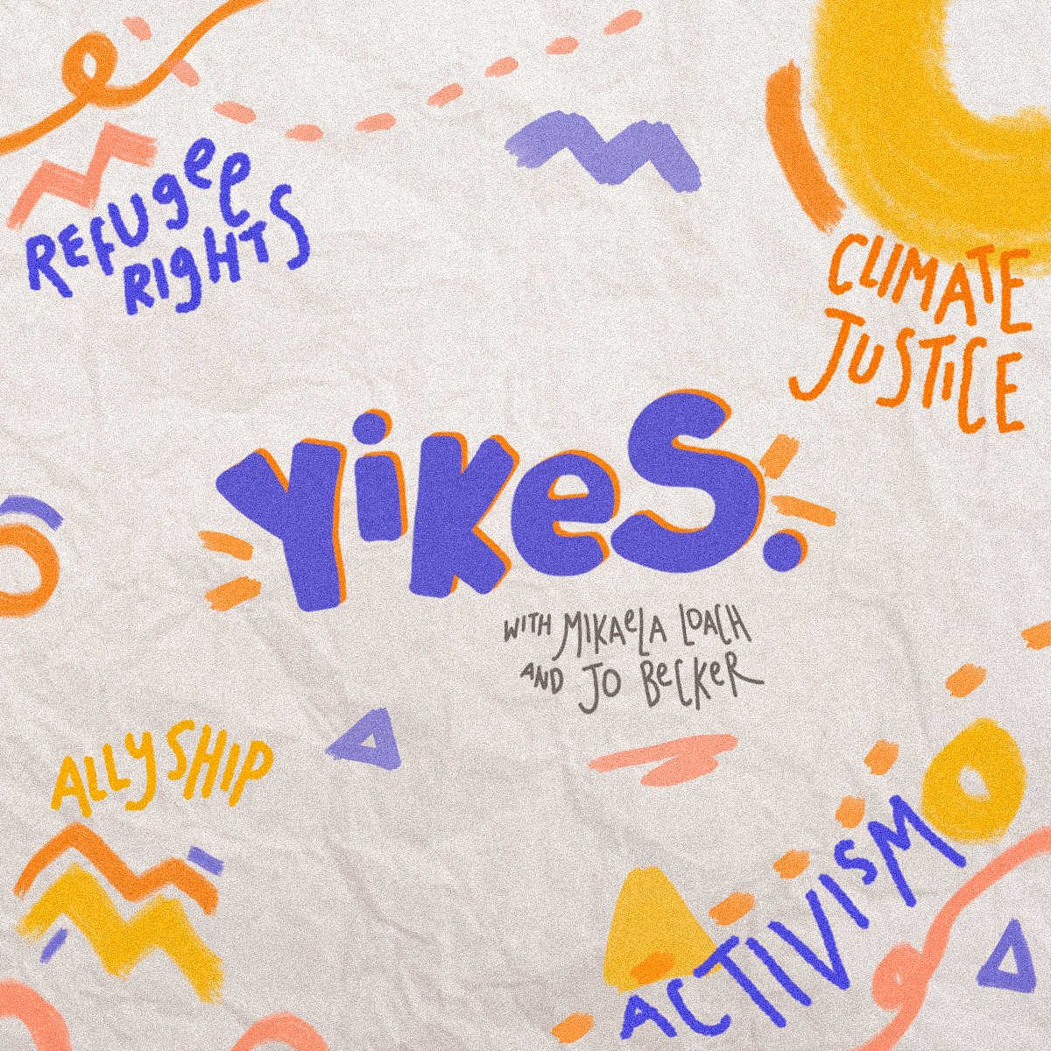
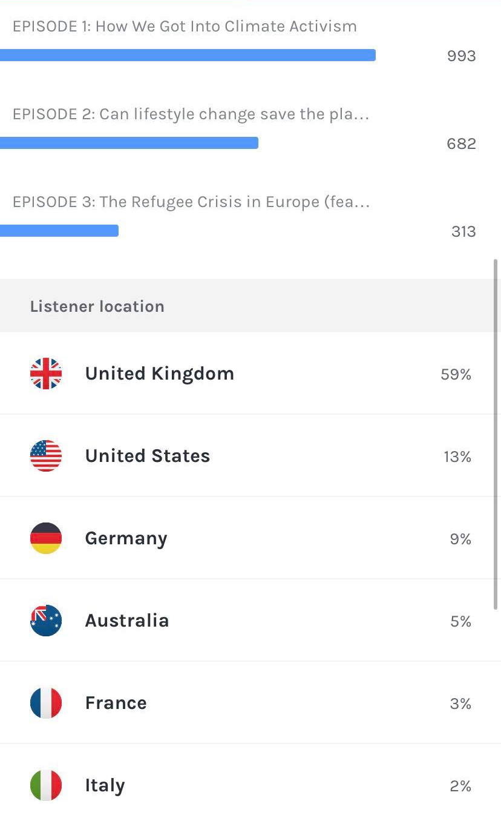
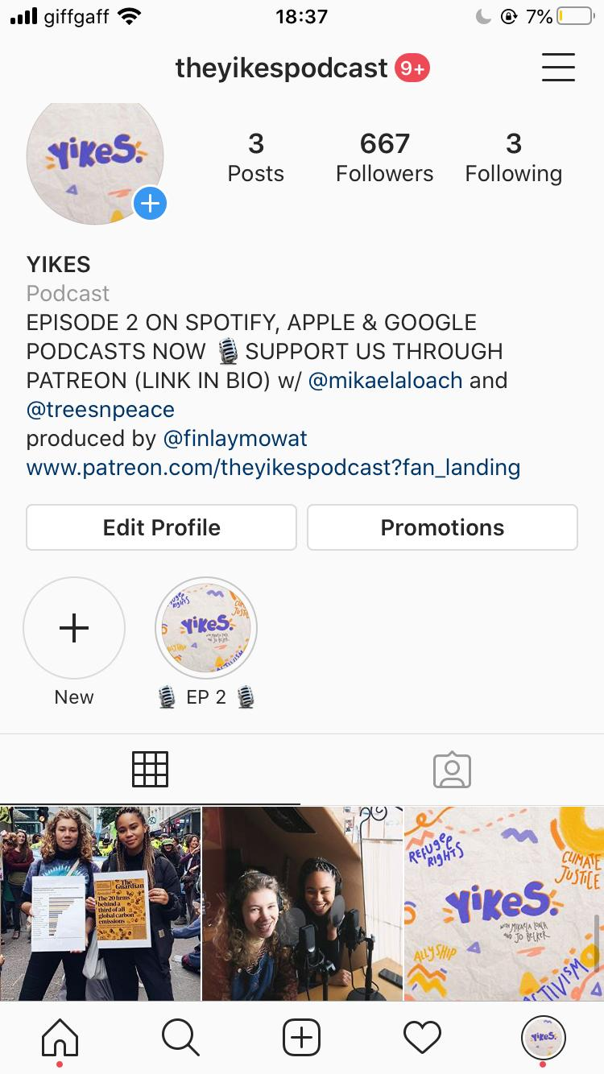
The YIKES Podcast
A podcast about sustainablity, climate justice, refugee rights and all kinds of intersectional activism
We wanted to make activism more accessible
Activism can seem inaccessible and daunting to get involved with.
Many of discussions in the social justice or climate justice spheres can present various barriers: language, lack of knowledge etc.
We wanted to break down some of these barriers to make these topics, and activism itself, more accessible to all.
The outcome
We have conversations at an introductory level, making sure we define key words and we have made sure the podcast has a relaxed feel, whilst not playing down the heavy topics we get into
Our podcast has only been out for a short while but has already had 2000 listens
We have created a community through the instagram account @theyikespodcast and the podcast itself and have received some really wonderful feedback! Many have got involved with activism for the first time since listening.
This is only the beginning. It has been so exciting so far!
@theyikespodcast on Instagram

